Slide 1



Slide 2
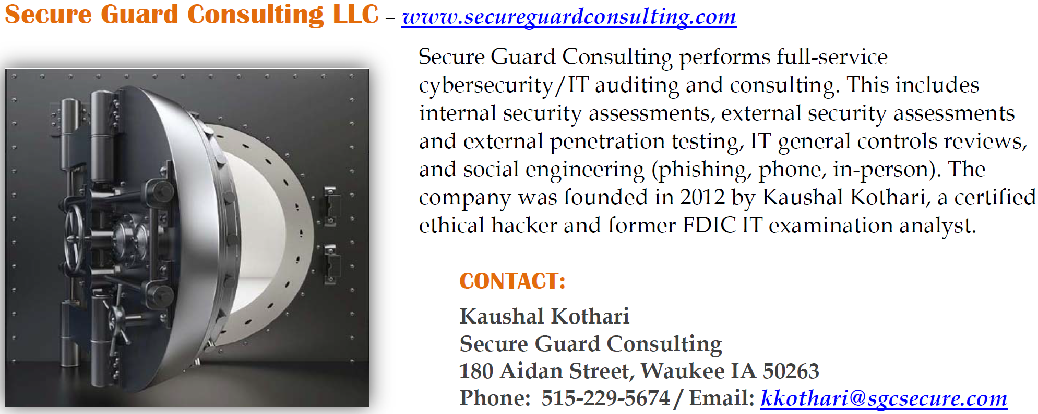
About Secure Guard Consulting
Invoike-GetAllExcludedUsersAndGroups.ps1

Slide 3
Agenda
Quick look at hardening
What if analysis PowerShell script
Backup and Restore PowerShell script - conditional access, authentication strength, etc.

Slide 4
Microsoft 365 – HARDENING

Slide 5
Complicit User Threat Model
When evaluating Microsoft 365 – and really any cloud-based services (e.g., Azure, AWS, etc.), banks should take the perspective of protecting against what we call “Complicit User”
  Where if an employee gave out their username, password, and MFA credentials (a complicit user), that that malicious actor, could still not access 365 or cloud resources on their own device
Modern conditional access design must go beyond just MFA. Authentication alone is not enough – need to be looking at each scenario and a block in place if certain conditions are not met.
Lots of banks are talking about Copilot – if you are not protected against the “Complicit User”, then you are NOT ready for Copilot!

Slide 6
Break Glass
All banks need to create a “break glass” account.
  Conditional access policies that “block” access to 365 resources require, at a minimum, an excluded user.
  This is where the break glass account comes in.
  Establish a break glass account …onmicrosoft.com – with Yubikey authentication and Yubikey stored in the bank’s vault or similar area.
  Use this account for excludes going forward.
If you have a SIEM or similar – work with the SIEM vendor or whatever method to produce an alert anytime the break glass account is accessed.

Slide 7
Simple Scenario #1
Bank wants only access to 365 resources within the bank’s walls
  No email on mobile phones
  No email on laptops outside of the bank
  Literally no access outside of the bank
Establish named locations (trusted IPs)
Set a conditional access policy to block “All Resources” outside of those trusted IPs.

Slide 8
Scenario #2 (Slightly More Complex)
Bank wants to open access up to mobile phones
  No email on Windows, Linux, MacOS – outside of trusted IPs
  Yes – we do want email on mobile phones (Android, iOS)
For Windows, Linux, MacOS – restrict only to trusted IPs (similar to scenario #1)
For Android, iOS – either implement Mobile Access Management or Intune.
  CA to force MAM or Intune
    MAM – access via Outlook app
    Intune – control of whole device
  CA to block all non registered
  Require a one time TAP for initial access – Android, iOS
  Require reauth to occur periodically (e.g., every 30 days)

Slide 9
Temporary Access Pass (TAP)
Create a TAP for all initial access to email via a Android and iOS.
https://youtu.be/PQ5aIemeGCQ?si=TU0ED2vHnNJgieic

Slide 10
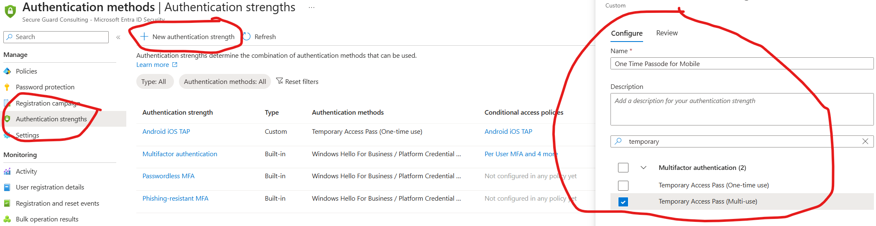
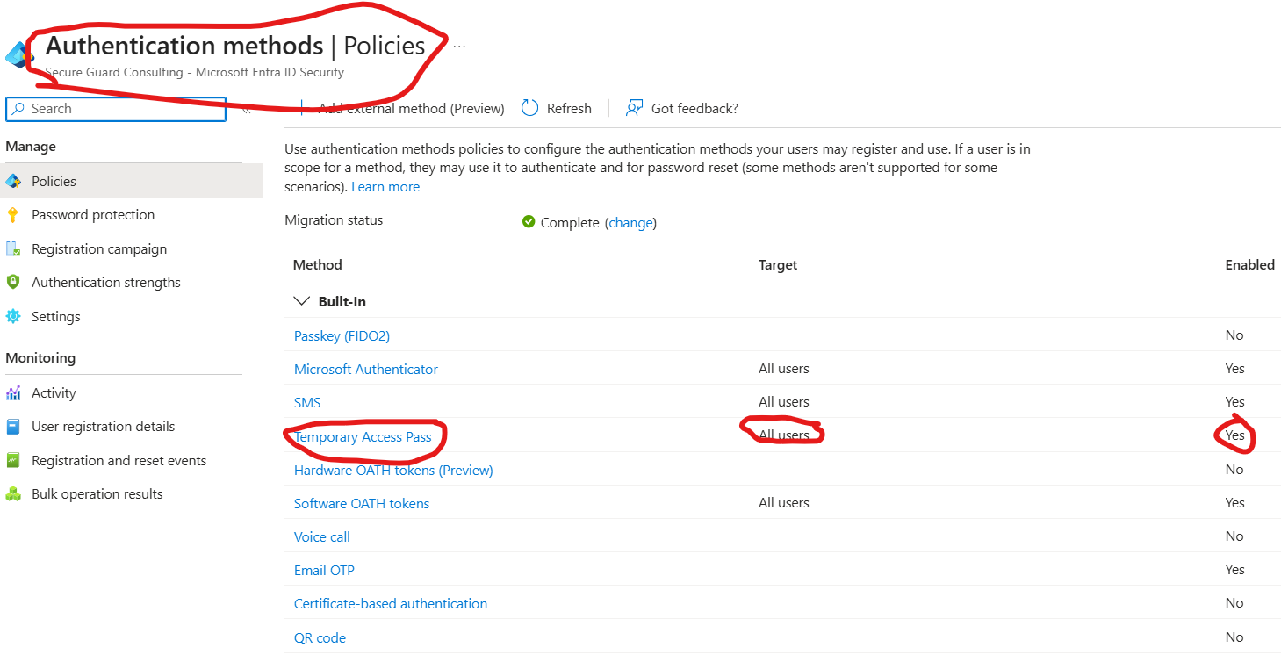
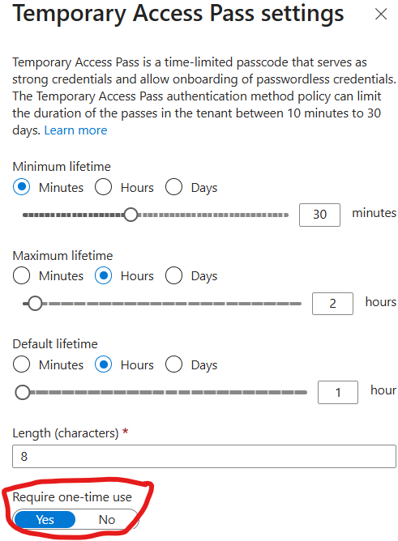

Slide 11
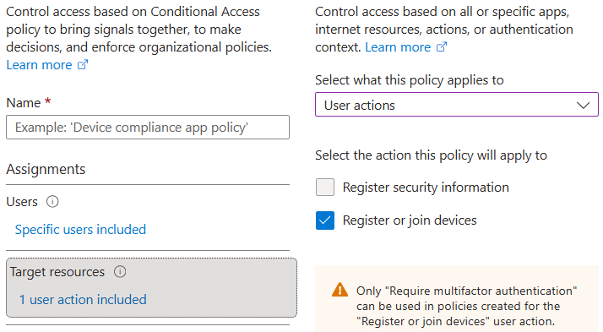
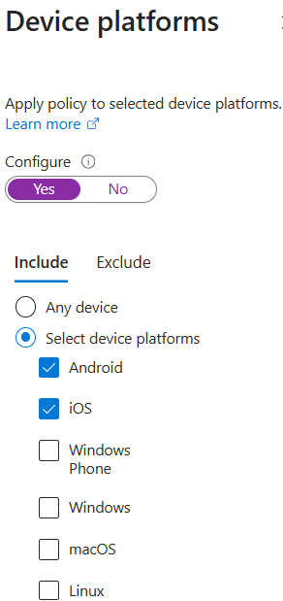
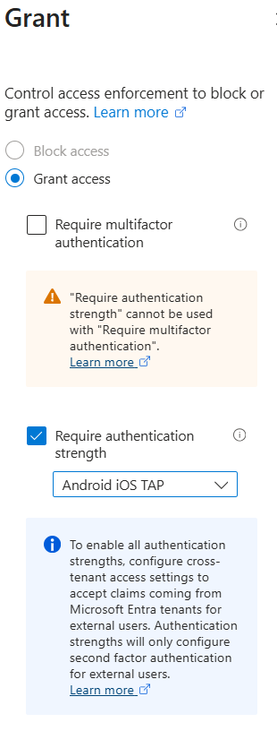

Slide 12
Establish App Protection Policies
Add app protection policies for both iOS and Android.
Set a conditional access policy – set the Grant to require app protection policy, as well as MFA. Have it reauthenticate every 30 days (or whatever frequency the bank would want).

Slide 13
Intune versus Mam
MAM – mobile access management – for personally owned mobile devices – forces access through Outlook app, provides ability to remote wipe the Outlook app.
Intune – for corporate owned mobile devices – can use other native email apps – controls the entire device.

Slide 14
Scenario #3
Typically larger banks with distributed work forces, but not necessarily.
A common example – when you want to be able to access email when offsite without VPN’ing into the network.
  Device trust
    Entra Joined - when you go directly to Entra to join a device
    Entra Hybrid Joined - where devices are sync'd between AD and Entra – hybrid environment
    Entra Registered - personal devices - so mobile
  Issue we’re seeing with a lot of banks is if the bank isn’t syncing properly between AD and Entra - join computer to AD, then log in, then sign into Outlook - a prompt similar to
    The organization would like to manage this device comes up - if the user chooses 'no' - then the device is invisible to admins. Which is what a hacker would want to do.
  We don’t want anyone connecting without us being able to see it.

Slide 15
1 Simple Method
Just do what we did with Android and iOS – and force 1 time TAP for all Windows, etc.
Problem – this is cumbersome.

Slide 16
Better Method
Make sure your AD environment is clean – remove old devices
Sync AD to Entra – so all devices sync’d will now be Entra Hybrid Joined
  Note: make sure only an admin can join a device to the domain
Now – for non-iOS and non-Android – it’s simple – block all access outside of devices that are not Hybrid Joined.
But - for Entra Hybrid Joined - you HAVE to manage devices properly in AD and set up syncing.

Slide 17
So Many Other scenarios
These are only 3 different scenarios – there are so many other use cases and scenarios.
It’s important to have the vendor helping to harden your environment understand how 365 services will be accessed and ensure complicit user protection is in place for how your bank accesses these resources.

Slide 18
What if script

Slide 19
Pre-What If
Excludes
  Script to identify all excludes
    Invoike-GetAllExcludedUsersAndGroups.ps1

Slide 20
What If
Actual what-if GUI
The Conditional Access What-If GUI:
  Tests one scenario at a time
  Is manual and slow
  Doesn’t scale well across users or combinations
  Overall just hard to validate coverage in an organized and efficient way

Slide 21
What If
We built a What-If analysis tool that:
  Uses the “what if” API
  Mirrors the GUI logic
  Tries realistic client app + device platform combinations
  Since automated – can run multiple users and scenarios easier and more rapidly
  Gives us a report to review and maintain

Slide 22
What If
We are evaluating the following device platforms:
  Linux, macOS, Windows, Windows Phone, iOS, and Android
For the following client apps:
  Browser, Modern authentication clients , Exchange ActiveSync (supported platforms), Exchange ActiveSync (unsupported platforms), and Other clients

Slide 23
What If
How We Model Exchange ActiveSync
  We align with how Conditional Access classifies EAS.
  EAS Supported Platforms iOS, Android, Windows
  EAS Unsupported Platforms Linux, macOS, Windows Phone
“Unsupported” does not mean insecure or impossible.
  It means how CA classifies the sign-in.

Slide 24
What If
I have added the following cloud apps – felt like this was a good representative sample.
  Cloud apps:
    Exchange Online
    SharePoint Online / OneDrive“
    Microsoft Graph
    Azure CLI
If you have servers in Azure or anything else – you would want to find the app id and add it to the script.

Slide 25
Backup and Restore

Slide 26
Backup and Restore
Backup-M365Policies.ps1 to back policies up.
  Conditional access policies
  Authentication strengths
  Authentication methods
  App protection profiles
Restore-M365Policies.ps1 to restore policies

